Slide 1


Wireshark
Presented By: Gouasmia Zakaria
Gouasmia.zakaria1@gmail.com

Slide 2
Network Protocol Analyzer
  Computer s/w or h/w, intercepts & logs traffic passing over the network
  Captures packets, decodes & analyzes contents
  A network Analyzer is used for
    Troubleshooting problems on the network
    Analyzing the performance of a network to discover bottlenecks
    Network intrusion detection
    Analyzing the operations of applications

Slide 3
Overview
Introduction to Wireshark
Features
Uses
> detecting VOIP problems
> downloading FLV files
What it can’t do
Conclusion

Slide 4
About Wireshark
It is a packet sniffer Computer application
Functionality is very similar to tcpdump
Has a GUI front-end and many more information sorting and filtering options
“eWeek” Labs named Wireshark one of "The Most Important Open-Source Apps of All Time" as of May 2, 2007

Slide 5
Background
Initiated by Gerald Combs under the name Ethereal
First version was released in 1998
The name Wireshark was adopted in June 2006

Slide 6
Features
“Understands" the structure of different network protocols.
Displays encapsulation and single fields and interprets their meaning.
It can only capture on networks supported by pcap.
It is cross-platform running on various OS (Linux, Mac OS X, Microsoft windows)

Slide 7
WinP Cap
Industries –standard tool for link layer network access in windows environment
Allows application to capture and transmit network packets by passing the protocol stack
Consists of a driver-extends OS to provide low level network access
Consists of library for easy access to low level network layers
Also contains windows version of libPCap Unix API

Slide 8
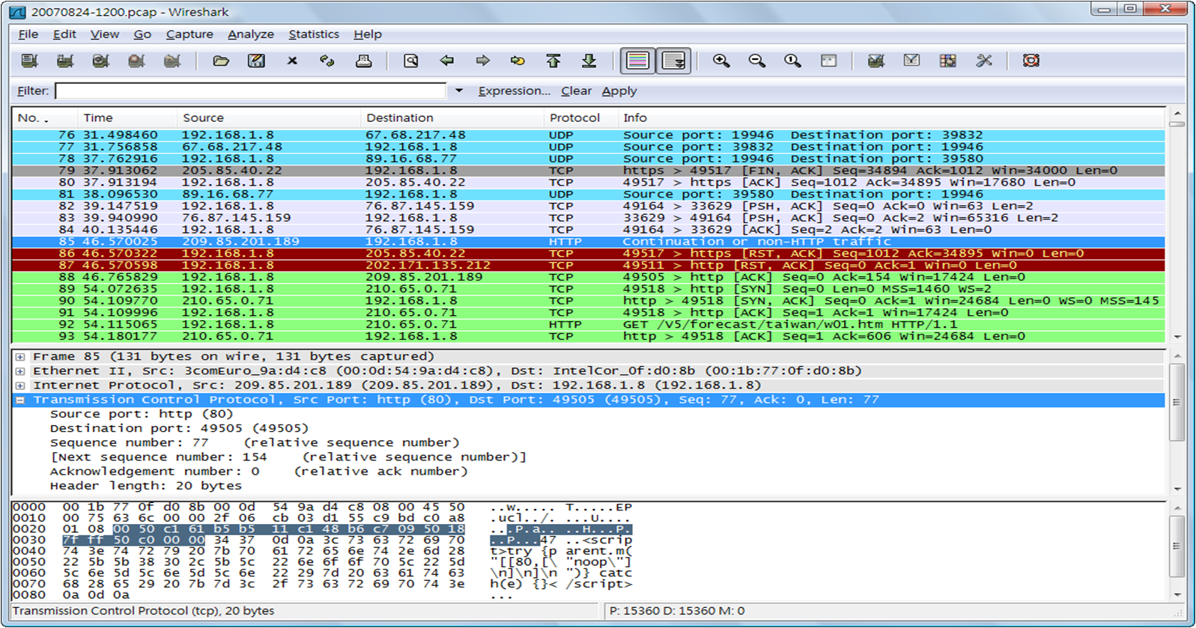
Example

Slide 9
Applications of Wireshark
Exposing VOIP problems
Supports Malware Detection
Helps recognize DOS attack
Downloading FLV files

Slide 10
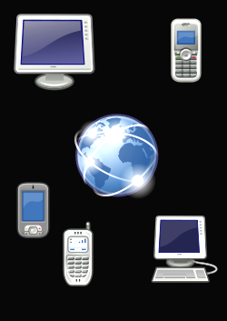
Exposing VoIP Problems Using Wireshark
VoIP –Protocol Optimized for transmission of voice through Internet(IP telephoning)
VOIP is affected by Latency, Jitter and Packet Loss
Troubleshooting VoIP network with other protocol analyzer software is costly
VoIP involves complex setup protocols that wireshark can decode and relate
It provides excellent tools to interpret the data

Slide 11
Exposing VOIP problems
VOIP suffers from three common problems
> when a number is dialed, phone idles & no
ringing is heard
> only one party hears audio
> missing conversation due to packet loss

Slide 12
No Ringing
When wireshark is launched we must ensure that correct interface is being used
Wrong user name & password
Phone
host
PBX
host
SIP INVITE
PROXY Authentication required
ACK

Slide 13
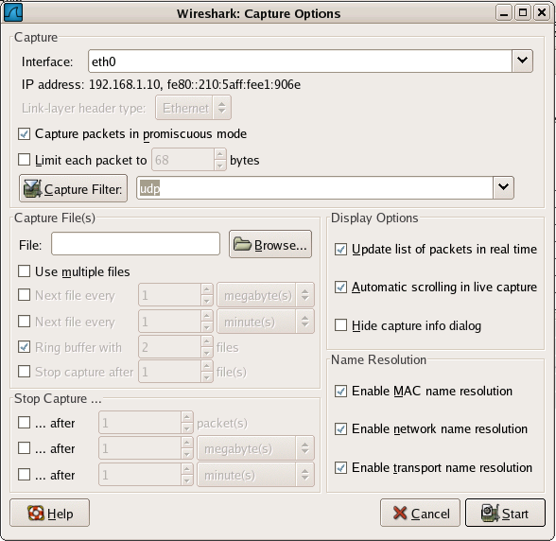
Capture Options

Slide 14
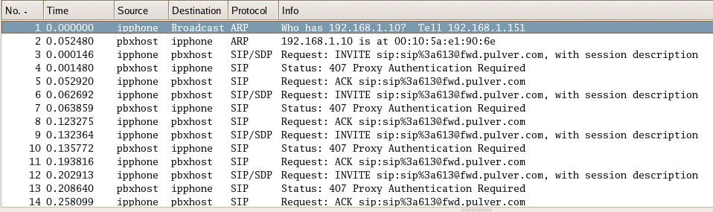
Capture of ipphone Traffic

Slide 15
One sided Audio
Uses advanced analysis tools
When capture is loaded, select Statistics->VOIP calls
Click on the call and Graph button- summary of SIP calls
Stream is set up between two end points by SIP using SDP
Decodes the protocol contained within currently selected packet

Slide 16
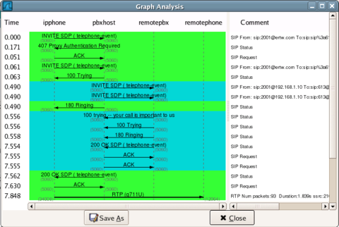
Graphical Interpretation

Slide 17
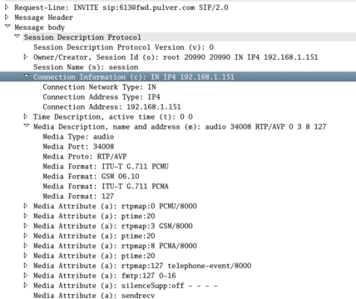
SIP packet Containing SDP

Slide 18
Session Description Protocol
Type: 3 (destination unreachable)
Code: 1 (host unreachable)
Checksum: 0x7a2

Slide 19
Problem
Given IP address is private and unreachable
So when remote host sends packets, they are lost as no such route exists

Slide 20
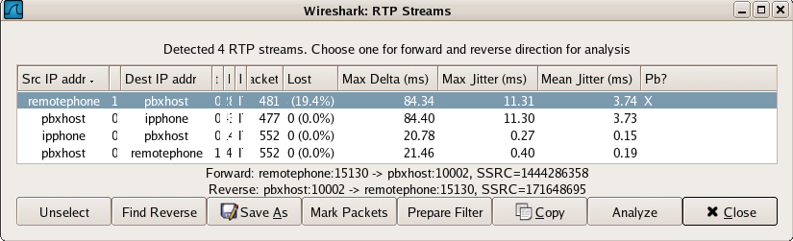
Partially audible conversation
Out of order packets are lost
Wireshark uses decoded packets to provide a list of all audio conversations

Slide 21
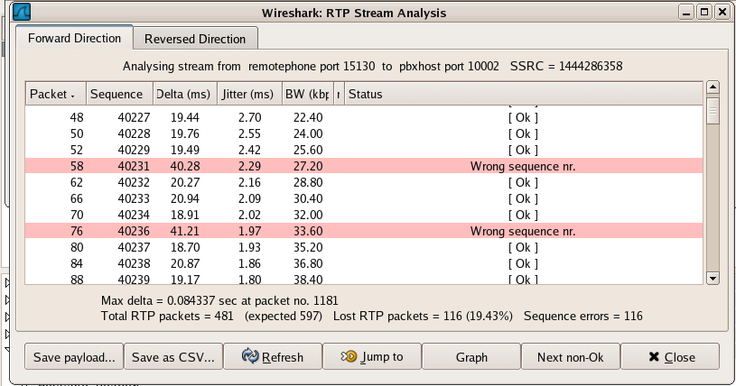
Stream Analysis
Select Problematic stream-> Click Find Reverse button-> Click Analyze to provided packet by packet look at the stream
Lost packets will show up as having the wrong sequence number
Also Displays current bandwith,latency and jitter

Slide 22
Audio replay
We can also listen to the content of the voice call
Select Save Payload button-> Select the .au file format-> press the OK button
The voice call is saved to your hard drive
Can be played by audio program like XMMS

Slide 23
What it Cannot Do….
It cannot be used to map out a network
It does not generate network data-Passive tool
Only shows detail information about protocols it understand
It can only capture data as well as the OS\Interface\Interface driver supports.
An example of this is capturing data over wireless networks.

Slide 24
Conclusion
Wireshark's wireless analysis features have grown to be a very powerful tool for troubleshooting and analyzing wireless networks.
With Wireshark's display filters and powerful protocol dissector features, you can sift through large quantities of wireless traffic
Without a doubt, Wireshark is a powerful assessment and analysis tool for wireless networks that should be a part of every auditor, engineer, and consultant toolkit.

